Slide 1
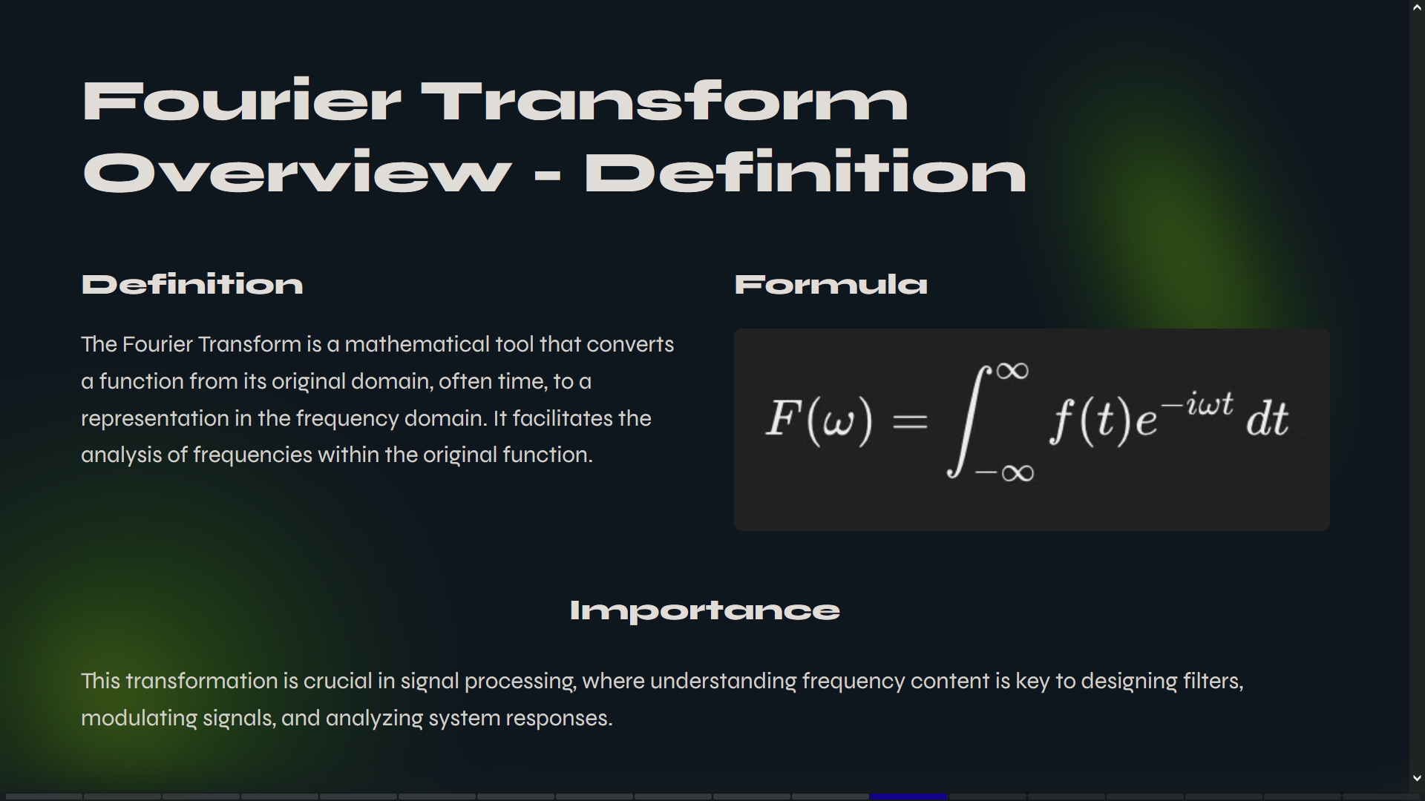

Slide 2
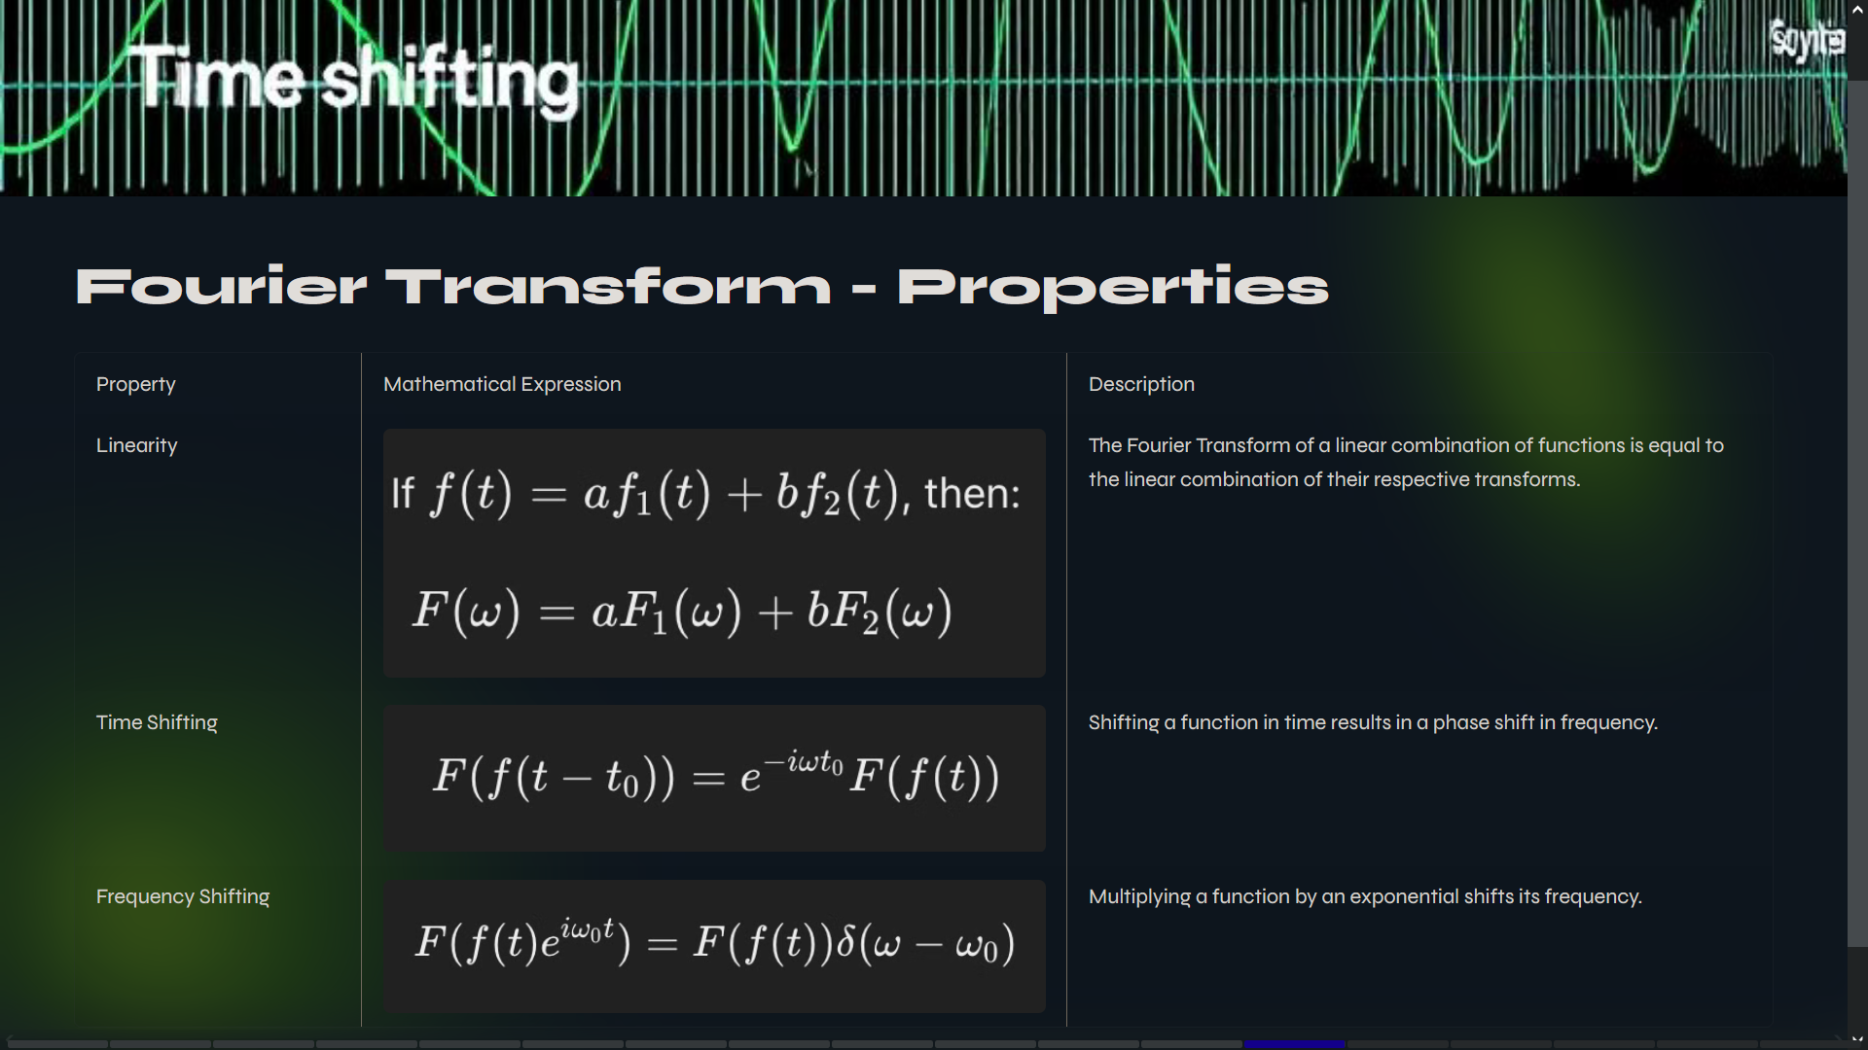

Slide 3
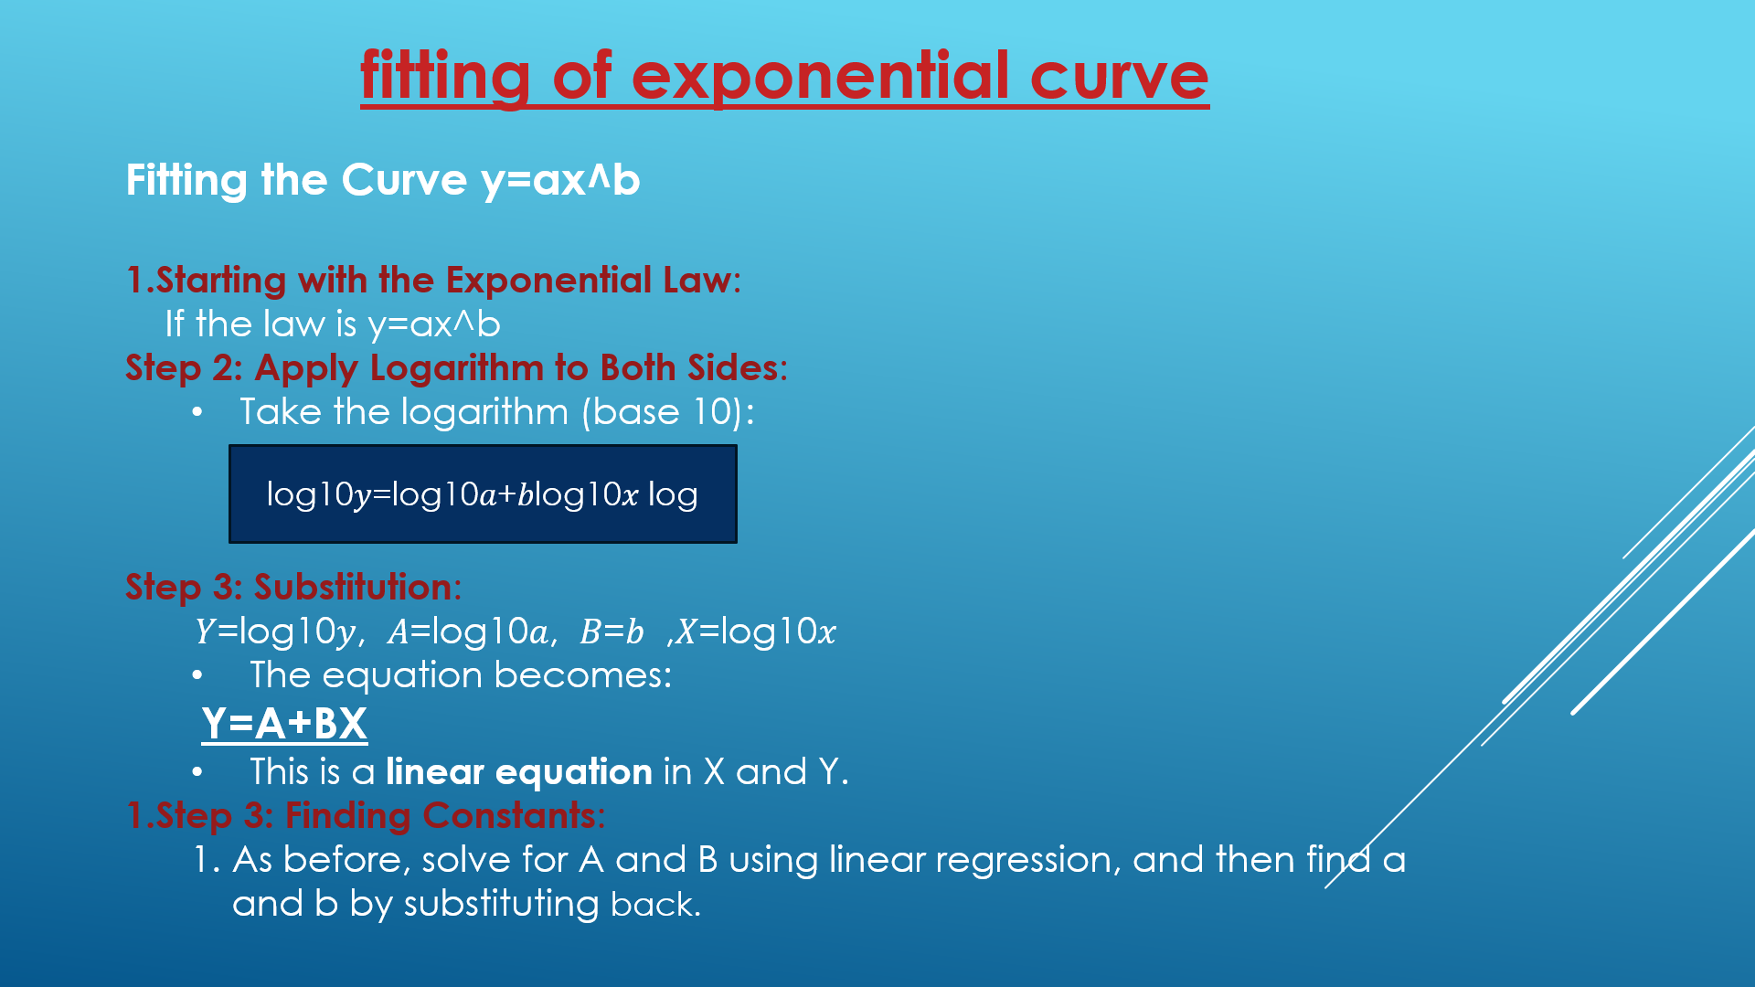
fitting of exponential curve
Fitting the Curve y=ax^b
Starting with the Exponential Law:
If the law is y=ax^b
Step 2: Apply Logarithm to Both Sides:
Take the logarithm (base 10):
Step 3: Substitution:
𝑌=log⁡10𝑦, 𝐴=log⁡10𝑎, 𝐵=𝑏 ,𝑋=log⁡10𝑥
The equation becomes:
Y=A+BX
This is a linear equation in X and Y.
Step 3: Finding Constants:
As before, solve for A and B using linear regression, and then find a and b by substituting back.
log⁡10𝑦=log⁡10𝑎+𝑏log⁡10𝑥 log

Slide 4

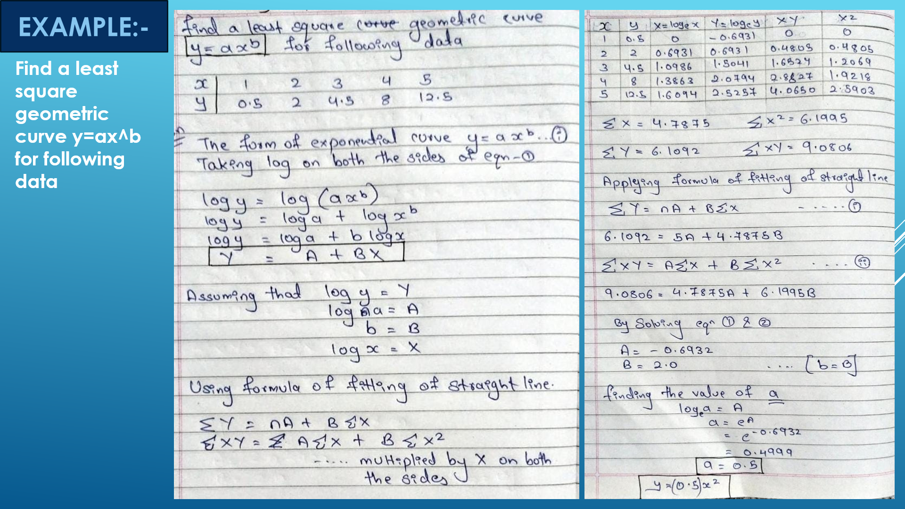
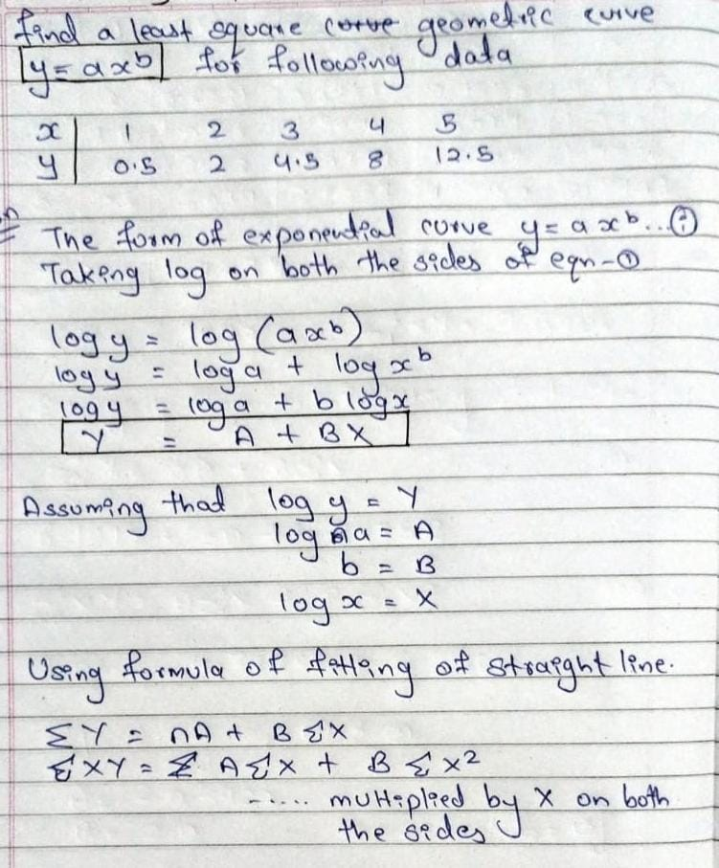
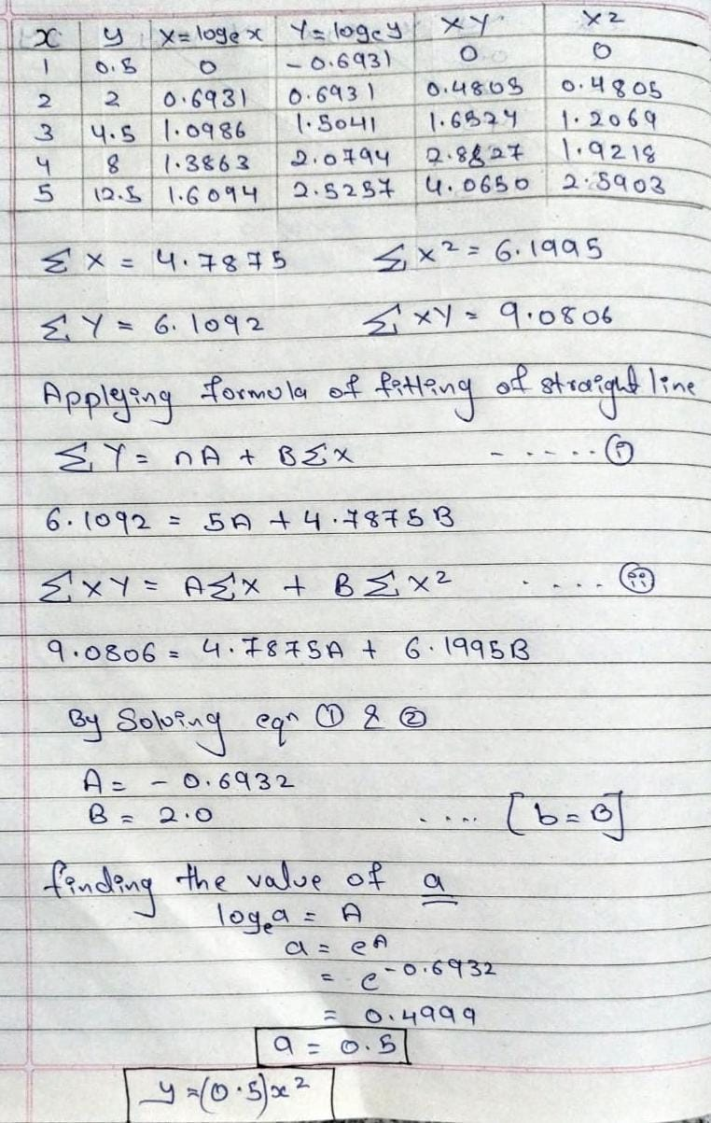
Find a least square geometric curve y=ax^b for following data

Slide 5
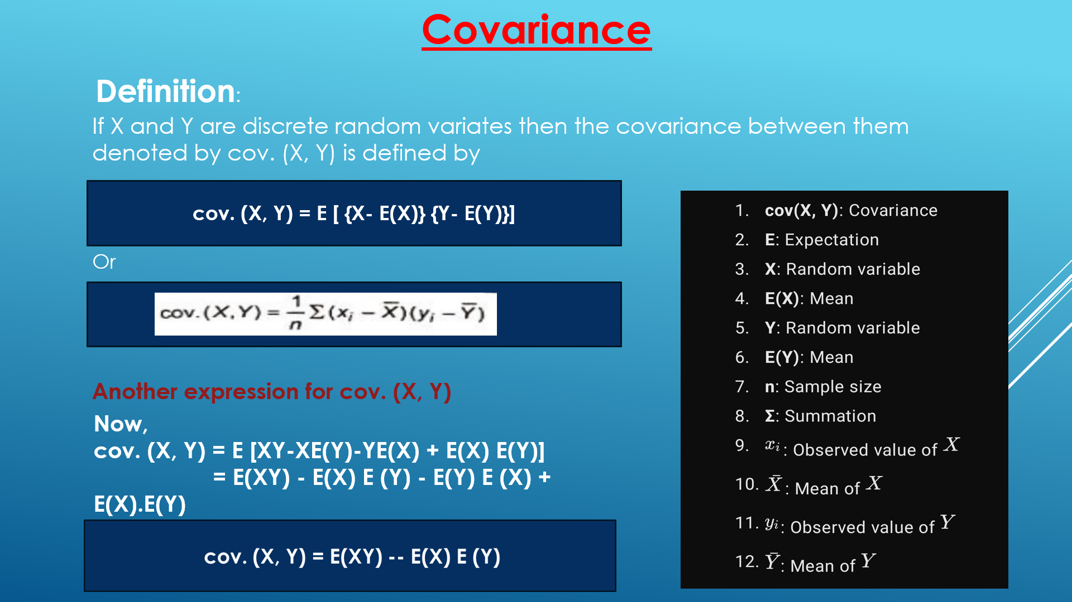

Slide 6
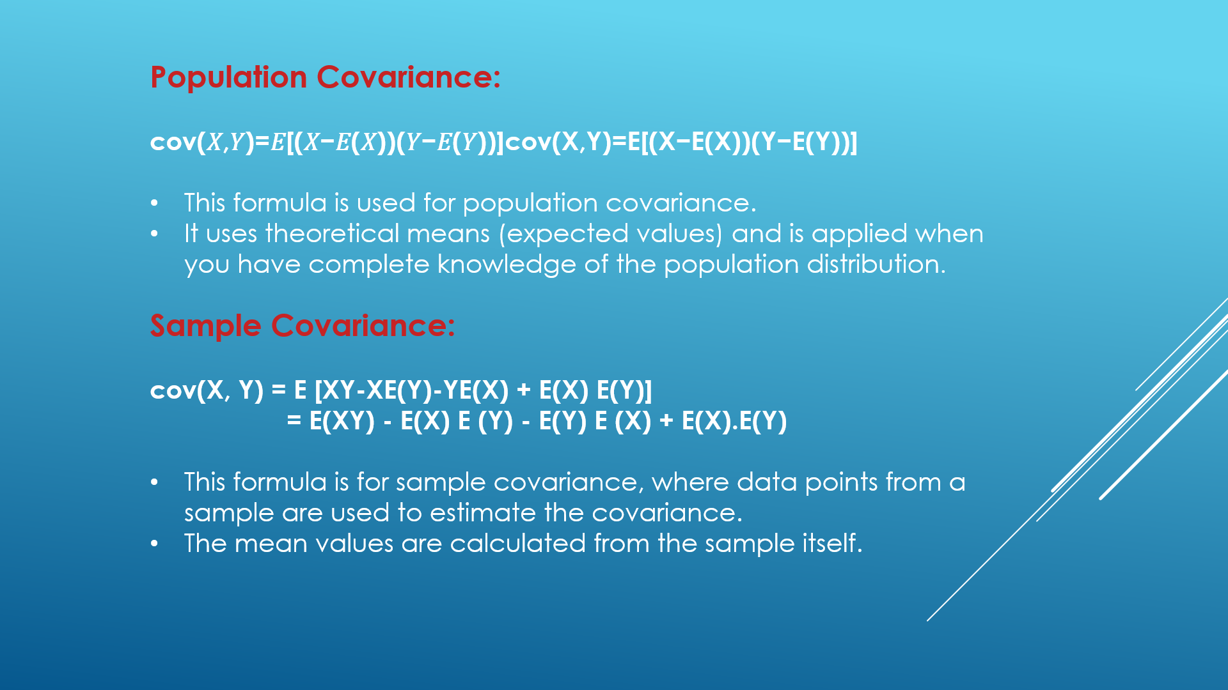

Slide 7
